Slide 1
SEMINAR PROJECT MANAGENMENT TOPIC: RISK MANAGEMENT
Instructors: Nguyễn Thanh Phước
Implementation members:
Nguyễn Văn Dũ – 16130332
Hồ Thanh Hiệp – 16130373
Trịnh Mạnh Hoàng – 16130392

Slide 2
MAIN CONTENTS
Risk Management Planning
Risk Management Process
Qualitative Risk Analysis
Quantitative Risk Analysis
Risk Response Planning
Risk Monitoring and Control

Slide 3
What is risk/risk management?
Any time there’s anything that might occur on your project and change the outcome of a project activity, we call that a risk. A risk can be an event (like a fire), or it can be a condition (like an important part being unavailable). Either way, it’s something that may or may not happen…but if it does, you will be forced to change the way you and your team work on the project.
Risk Management is the process of identifying, analyzing and responding to risk factors throughout the life of a project and in the best interests of its objectives. Proper risk management implies control of possible future events and is proactive rather than reactive.

Slide 4
Why need risk management?
The purpose of risk management is to:
Identify possible risks.
Reduce or allocate risks.
Provide a rational basis for better decision making in regards to all risks.
Assessing and managing risks is the best weapon you have against project catastrophes. By evaluating your plan for potential problems and developing strategies to address them, you’ll improve your chances of a successful, if not perfect, project.

Slide 5
Why do risk management?
Additionally, continuous risk management will:
Ensure that high priority risks are aggressively managed and that all risks are cost-effectively managed throughout the project.
Provide management at all levels with the information required to make informed decisions on issues critical to project success.

Slide 6
How to do risk management?

Slide 7
Risk Management Planning
What’s risk management planning
As stated above, risks are any events or conditions that affect the plan that affects the outcome of the project set out earlier, so what is the plan to manage risk, is the process by which We devise a risk management plan to approach risks scientifically and systematically to identify, control, prevent and minimize losses and loss of adverse effects of risks.

Slide 8
Risk Management Planning
Why we need to risk management planning
There is no guarantee that your project will go smoothly with the plan you have set, any small fluctuations can occur in your project and it will also affect a somehow comes to the project plan and changes the results, schedule, plan of the project. And we call it risk.
By the time the risk actually occurred to your project, it was too late to do anything about it. That's why you need to plan for risk in the first place and keep coming back for more planning throughout the project.
The risk management plan tells you how you will handle risks in your project. This document records how you assess the risk, who is responsible for the implementation, and how often you conduct risk planning.

Slide 9
Risk Management Planning
How to planning with risk.
When you plan your project, the risks are still uncertain. But in the end, some of the risks you plan to take place, and that's when you need to deal with them. And here we have four basic ways to handle risk
Avoid
Is trying to avoid, eliminate or minimize the likelihood of risk (it's like you will limit or not go out at 12 pm to avoid being killed)
Mitigate
As a measure to minimize the possible damage (this method is like you wear a helmet when driving to minimize the possibility of an accident and injure you)

Slide 10
Risk Management Planning
Transfer
Risk transfer is the most ideal model, from rudimentary risk transfer to insurance participation. This is the most effective and effective tool to deal with losses. (For example, instead of transporting a truck of smuggled cigarettes to the male, you divide the cigarette into smaller chunks and transport it to each different vehicle in case the police get caught. whole car cigarette)
Accept
This is the form by which the victim accepts that loss and usually, there are two ways to accept the risk, which is to be proactive and passive.
Passive acceptance is the absence of preparation for risk to find a solution and compensate.
Proactive acceptance is the establishment of a resource reserve fund to compensate for the risks occurring. And often resources will not be used optimally, even very passively because the level of losses is not completely the same and unpredictable.

Slide 11
Risk Management Process
What’s it?
Project risk management is a process that includes risk assessment and mitigation strategies for those risks. Risk assessment includes both identifying potential risks and assessing the potential impacts of risks. A risk mitigation plan is designed to eliminate or minimize the impact of risk events that occur when they occur that negatively affect the project. Identifying risk is a creative and disciplined process. The creative process consists of brainstorming sessions in which the team is required to create a list of everything that can go wrong. All ideas are welcome at this stage with the evaluation of ideas coming later.

Slide 12
Risk Management Process
Risk Identification
A more disciplined process consists of using the checklist of potential risks and assessing the likelihood that such events may occur within the project. A number of companies and industries have developed a risk checklist based on experience from past projects. These checklists can be helpful for project managers and project teams in identifying both specific risks in checklists and extending team thinking. Past experience of the project team, project experience in the company and industry experts can be a valuable resource to identify potential risks to a project.
Identifying sources of risk according to the portfolio is another method to explore potential risks on a project. Some examples of categories for potential risks include:

Slide 13
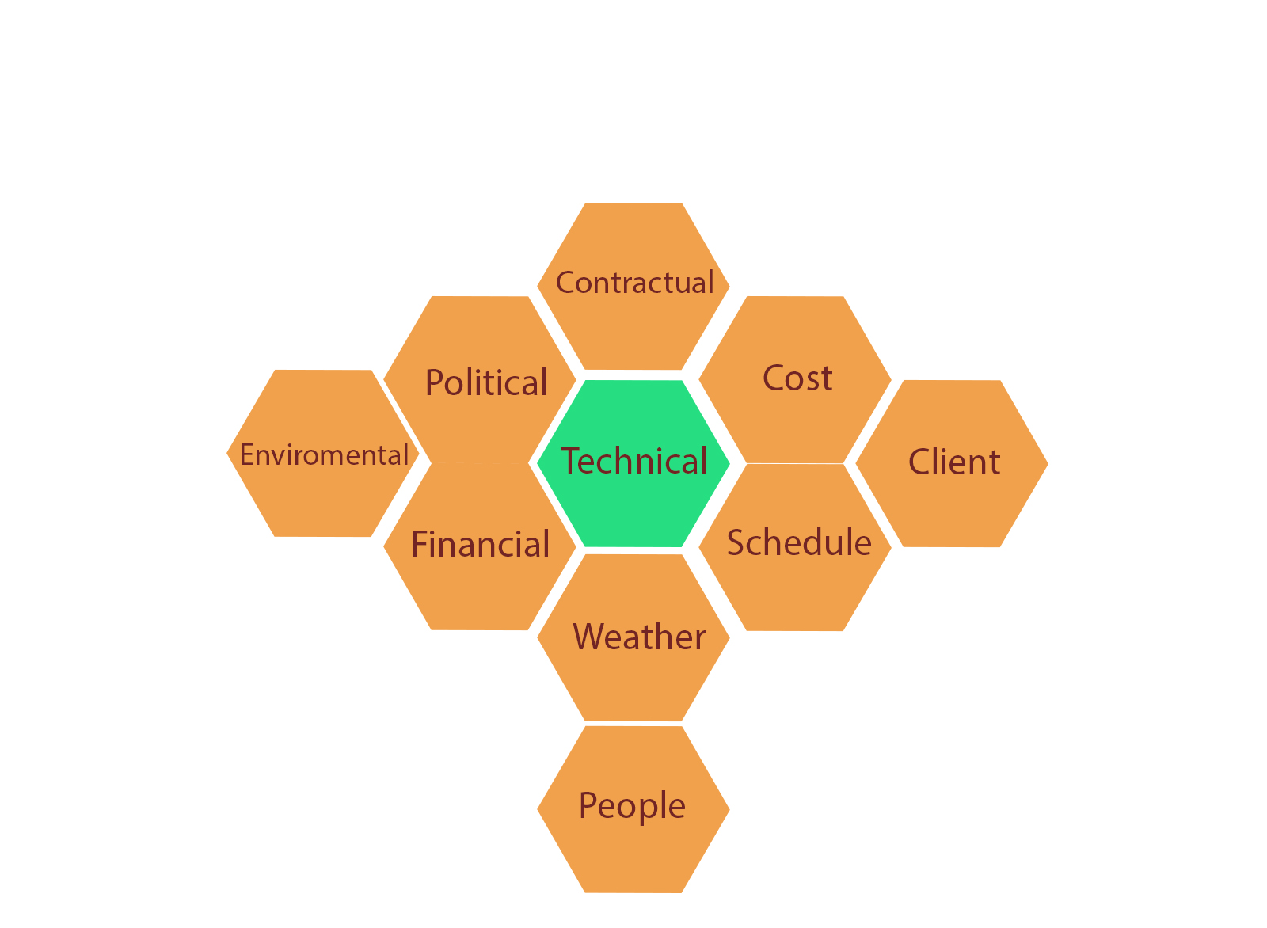
Risk Management Process

Slide 14
Risk Management Process
In fact, depending on the business, the company, there will be different frameworks to divide the work and develop risks.
Here we will describe a framework to divide and develop risks which are WBS (work breakdown structure).
This framework divides the work and risk structure into a table with 2 columns (1 column is the task and 1 column is the possible risk at that task).

Slide 15
Risk Management Process
Task | Risk
Contact Dion and Carlita | Dion backs out Carlita backs out No common date available
Host planning lunch | Restaurant full or closed Wring choice of ethnic food Dion or Carlita have special food allergies or preferences
Develop and distribute schedule | Printer out of toner Out of paper

Slide 16
Risk Management Process
This approach helps the project team identify known risks, but can be limited and less creative in identifying unknown risks and risks not easily found in WBS.

Slide 17
Risk Management Process
Risk Evaluation
After identifying the potential risks, the project team will evaluate each risk based on the probability of the event of the risk and the potential loss associated with it. Not all risks are the same. Some risk events are more likely to occur than others and risk costs can vary greatly. Assessing the risk of the probability of occurrence and the severity or potential loss to the project is the next step in the risk management process.
Having criteria to identify high impact risks can help narrow the focus to a few important risks that need to be minimized. For example, suppose that high-impact risks are those that can increase project costs by 5% of the concept budget or 2% of the detailed budget. Only a few potential risk events meet these criteria. Here are a few important potential risk events that the project management team should focus on when developing a project or management risk mitigation plan. The risk assessment is about developing an understanding of what is potentially the most likely to occur and can have the greatest negative impact on the project.

Slide 18
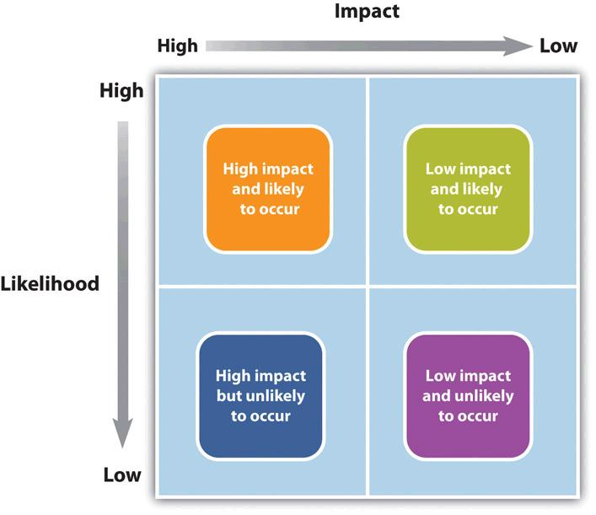
Risk Management Process

Slide 19
Risk Management Process
Risk Mitigation
After identifying and assessing risks, the project team developed a risk mitigation plan, which is intended to reduce the impact of an unexpected event. Project teams minimize risks in several different ways:
Avoid
Mitigate
Transfer
Accept

Slide 20
Risk Management Process
Contingency Plan
Project teams often develop an alternative method to accomplish a project goal when a risk event has been identified that can discourage the achievement of that goal. These plans are called contingency plans.
Example: The risk of a strike truck driver can be mitigated by a contingency plan using a train to transport the equipment needed for the project. If a critical part of the device is late, the impact on the schedule can be minimized by changing the schedule to accommodate late device delivery.

Slide 21
Risk Management Process
Project Risk By Phases
Initiation
Project risks are handled in different ways depending on the stage of the project.
Start:
Risks related to the unknown. Many things are unknown at the start of the project, but the risks must be considered in the inception phase and weighed against the potential benefits of the project's success to decide whether or not to choose the project.

Slide 22
Risk Management Process
Project Risk By Phases
Planning phases
Once the project is approved and it moves into the planning stage, risks are identified for each major activity group. A risk division structure (RBS) can be used to determine the level of detailed risk analysis.
Implementation phases
As the project progresses and more information is available to the project team, the overall risk on the project often decreases, because the activities are carried out without loss. The risk plan should be updated with new information and check the risks associated with the activities performed.
Closeout Phases
In the closing phase, risk sharing and risk transfer arrangements should be signed and the risk-sharing structure checked to ensure that all risk events have been avoided or minimized. Final estimates of risk losses can be made and recorded as part of the project document.

Slide 23
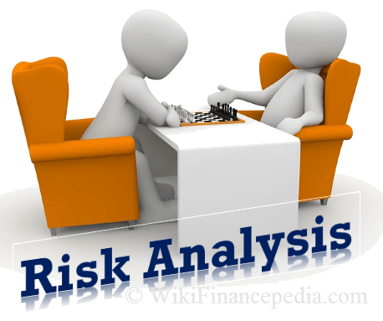
RISK ANALYSIS
What is Risk Analysis?
Once you have identified the risks that could affect your project, you need to determine which ones you will spend time and money on.
Risk analysis is the process of prioritizing risks based on the probability of the risk occurring and the impact it would have on the project.

Slide 24
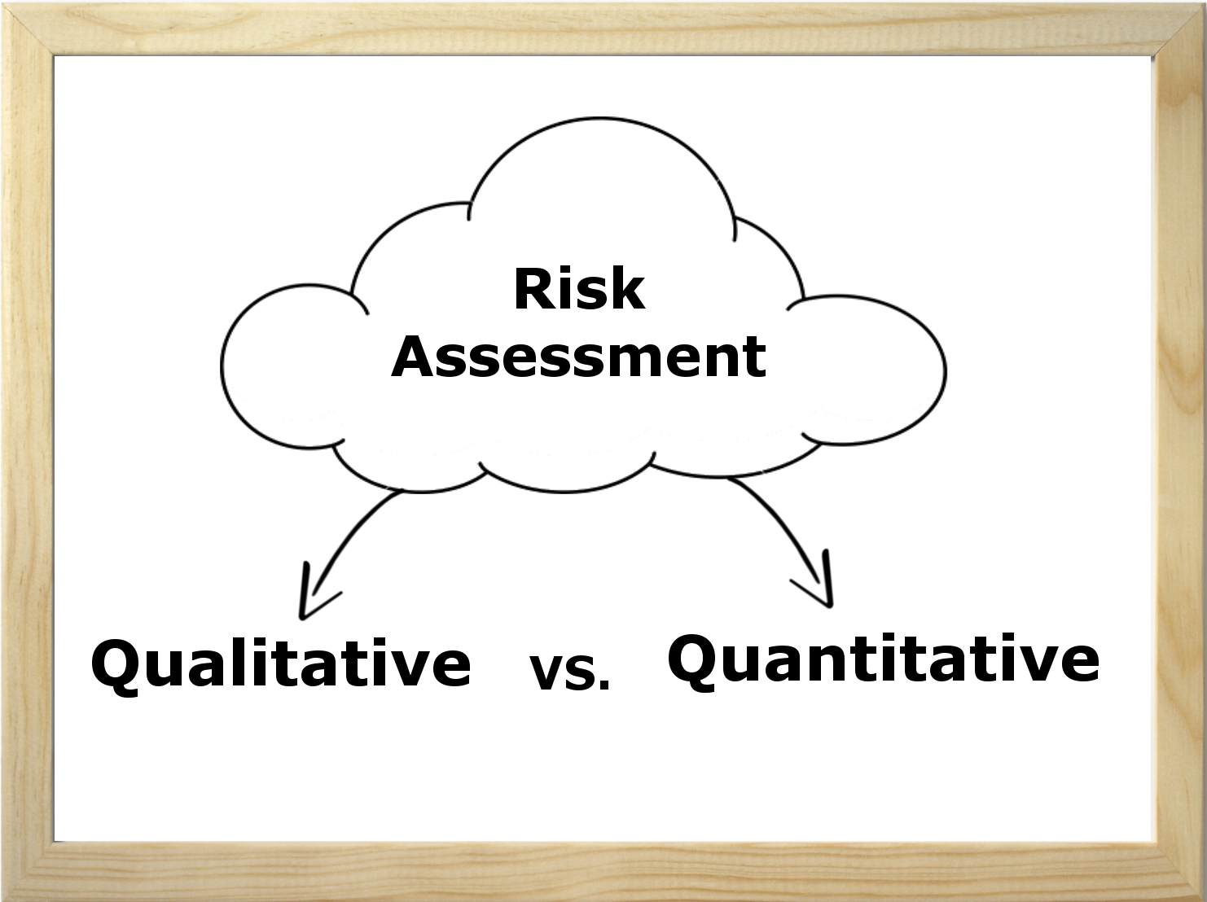
RISK ANALYSIS
There are two primary methods of risk analysis you can use on your project
Quantitative Risk Analysis
Qualitative Risk Analysis

Slide 25

QUANTITATIVE RISK ANALYSIS
Qualitative risk analysis is a technique used to quantify risk associated with a particular hazard. Risk assessment is used for uncertain events that could have many outcomes and for which there could be significant consequences.

Slide 26
THE RISK ASSESSMENT MATRIX
A Risk Assessment Matrix (RAM) is a tool to help you determine which risks you need to develop a risk response for.
The first step in developing a RAM is to define the rating scales for likelihood and impact.
In a qualitative analysis, likelihood or probability is measured using a relative scale. Here's an example Likelihood Scale definition...
RATING | LIKELIHOOD | DESCRIPTION
1 | Very Low | Highly unlikely to occur. May occur in exceptional situations.
2 | Low | Most likely will not occur. Infrequent occurrence in past projects.
3 | Moderate | Possible to occur.
4 | High | Likely to occur. Has occurred in past projects.
5 | Very High | Highly likely to occur. Has occurred in past projects and conditions exist for it to occur on this project.

Slide 27
THE RISK ASSESSMENT MATRIX
Here's an example Impact Scale definition...
RATING | IMPACT | COST | SCHEDULE
1 | Very Low | No increase in budget | No change to schedule
2 | Low | < 5% increase in budget | < 1 week delay to schedule
3 | Moderate | 5-10% increase in budget | 1 - 2 weeks delay to schedule
4 | High | 10-20% increase in budget | 2 - 4 weeks delay to schedule
5 | Very High | > 20% increase in budget | > 4 weeks delay to schedule

Slide 28
THE RISK ASSESSMENT MATRIX
Remember, these scales are very dependent on the specific details of your project.
For example, a "Low" likelihood of occurrence for one project may mean a risk event is unlikely to occur within the next 10 deployments.
The impact scale for your project could also include other considerations such as scope, political, and employee impacts.

Slide 29
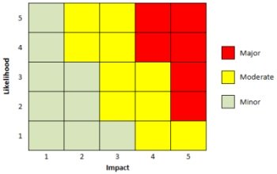
THE RISK ASSESSMENT MATRIX
With your rating scales prepared, you can create a Risk Assessment Matrix to help you categorize the Risk Level for each risk event.
Risk Assessment Matrix

Slide 30
QUALITATIVE RISK ASSESSMENT
Using your RAM and Rating Scales, you can then analyze the likelihood of each risk event occurring and its impact to determine what Risk Level it is at. This will give you the information you need to prioritize your list of project risks.
A qualitative risk assessment can also help you determine if there are any specific types or categories of risks that would require special attention or any risk events that need to be handled in the near-term.
The most challenging aspect of performing a qualitative risk analysis is defining your rating scales. But once that has been done, you can use them for the duration of the project to effectively manage your project's risks in a timely manner.

Slide 31
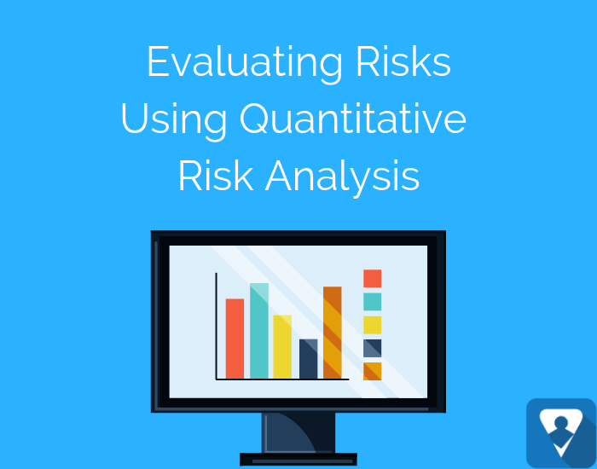
QUALITATIVE RISK ANALYSIS
Project managers should be prepared to perform different types of risk analysis. For many projects, the quicker qualitative risk assessment is all you need. But there are occasions when you will benefit from a quantitative risk analysis.
Let’s take a look at this type of analysis: What is it? Why should we perform it? When should it be performed? And how do we quantify risks?

Slide 32
WHAT IS QUANTITATIVE RISK ANALYSIS?
Qualitative risk analysis is a numeric estimate of the overall effect of risk on the project objectives such as cost and schedule objectives. The results provide insight into the likelihood of project success and is used to develop contingency reserves.

Slide 33
WHY PERFORM QUANTITATIVE RISK ANALYSIS?
Better Overall Project Risk Analysis
Individual risks are evaluated in the qualitative risk analysis. But the quantitative analysis allows us to evaluate the overall project risk from the individual risks.
Better Business Decisions
Business decisions are rarely made with all the information or data we desire. For more critical decisions, quantitative risk analysis provides more objective information and data than the qualitative analysis. Keep in mind: While the quantitative analysis is more objective, it is still an estimate. Wise project managers consider other factors in the decision-making process.
Better Estimates
A project manager estimated a project's duration at eight months with a cost of $300,000. The project actually took twelve months and cost $380,000. What happened?
The project manager did a Work Breakdown Structure (WBS) and estimated the work. However, the project manager failed to consider the potential impact of the risks (good and bad) on the schedule and budget.

Slide 34
WHEN TO PERFORM QUANTITATIVE RISK ANALYSIS?
First, we identify risks. Then we can evaluate the risks qualitatively and quantitatively.
Consider using Quantitative Risk Analysis for:
Projects that require a Contingency Reserve for the schedule and budget.
Large, complex projects that require Go/No Go decisions (the Go/No Go decision may occur multiple times in a project).
Projects where upper management wants more detail about the probability of completing the project on schedule and within budget.

Slide 35
WHAT IS THE DIFFERENCE BETWEEN QUALITATIVE AND QUANTITATIVE RISK ANALYSIS?
The main difference between these two methods of risk analysis is that qualitative risk analysis uses a relative or descriptive scale to measure the probability of occurrence whereas quantitative risk analysis uses a numerical scale.
For example, a qualitative analysis would use a scale of "Low, Medium, High" to indicate the likelihood of a risk event occurring.
A quantitative analysis will determine the probability of each risk event occurring. For example, Risk #1 has an 80% chance of occurring, Risk #2 has a 27% chance of occurring, and so on.

Slide 36
QUANTITATIVE RISK ASSESSMENT TOOLS & TECHNIQUES
Three Point Estimate – a technique that uses the optimistic, most likely, and pessimistic values to determine the best estimate.
Decision Tree Analysis – a diagram that shows the implications of choosing one or other alternatives.
Expected Monetary Value (EMV) – a method used to establish the contingency reserves for a project budget and schedule.
Monte Carlo Analysis – a technique that uses optimistic, most likely, and pessimistic estimates to determine the total project cost and project completion dates.
Sensitivity Analysis – a technique used to determine which risks have the greatest impact on a project.
Fault Tree Analysis (FMEA) – the analysis of a structured diagram which identifies elements that can cause system failure.

Slide 37
QUANTITATIVE RISK ANALYSIS EXAMPLE
Let’s look at a simple Expected Monetary Value (EMV) example:
Keep in mind that risks include both threats and opportunities. Threats have adverse impacts on cost. Opportunities are benefits that reduce cost. Expected Monetary Value = Probability x Impact.
Risk | Probability | Cost Impact | EMV
A (Threat) | 20% | $100,000 | $20,000
B (Opportunity) | 40% | ($10,000) | ($4,000)
C (Threat) | 30% | $50,000 | $15,000
Total EMV |  |  | $31,000

Slide 38
RISK RESPONSE PLANNING
The risk response planning is the process of developing options, and determining actions to enhance opportunities and reduce threats to the project’s objectives. It follows the Qualitative Risk Analysis and Quantitative Risk Analysis processes. It includes the identification and assignment of one or more persons (the “risk response owner”) to take responsibility for each agreed-to and funded risk response. Risk Response Planning addresses the risks by their priority, inserting resources and activities into the budget, schedule, and project management plan, as needed.

Slide 39
RISK RESPONSE PLANNING
The purpose of this process is to ensure that each of the identified risks on the Risk Register has appropriate actions or plans to mitigate or avoid a risk before it happens or to provide a response when a risk occurs and turns into a project issue.

Slide 40
RISK RESPONSE PLANNING
Parts of a Risk Response:
Cost effective relative to the significance of the risk
Scaled to the magnitude of the risk
Agreed upon by the applicable project stakeholders
Achievable and realistic

Slide 41
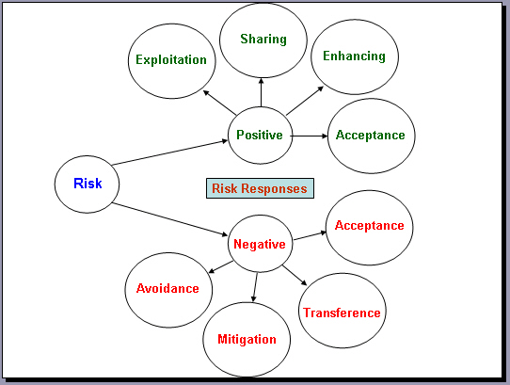
RISK RESPONSE PLANNING
How to Response:

Slide 42
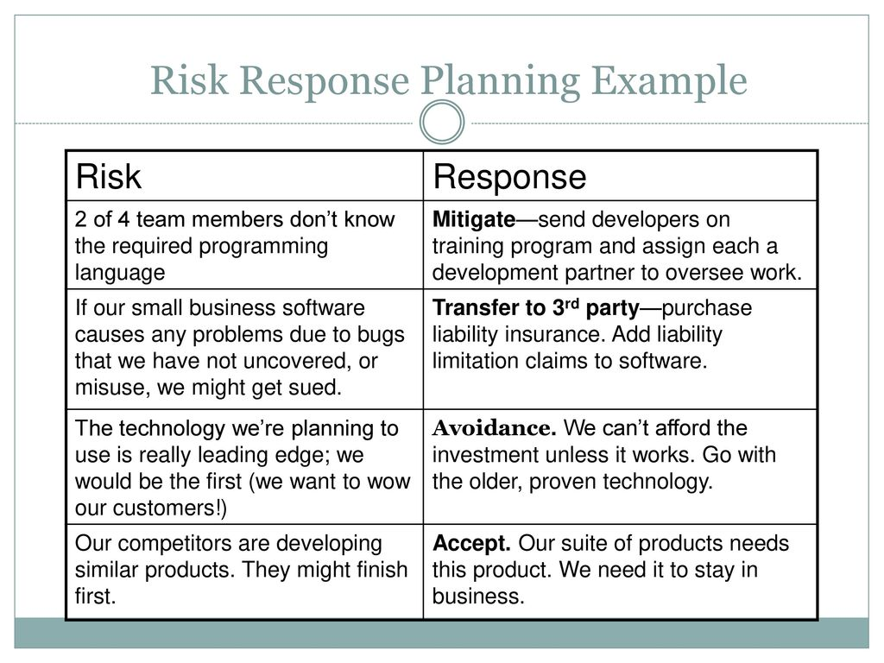
RISK RESPONSE PLANNING
Example:

Slide 43
RISK RESPONSE PLANNING
It is not required to eliminate all the risks of the project due to resource and time constraints. A project manager should review risk throughout the project. Planning for risks is iterative. Qualitative risk, quantitative risk, and risk response planning do not end ones you begin work on the project.

Slide 44
RISK MONITORING AND CONTROL
Risk monitoring and control is the process of identifying, analyzing, and planning for newly discovered risks and managing identified risks. Throughout the process, the risk owners track identified risks, reveal new risks, implement risk response plans, and gage the risk response plans effectiveness. The key point is throughout this phase constant monitoring and due diligence is key to the success

Slide 45
RISK MONITORING AND CONTROL
Risk monitoring and control is required in order to:
Ensure the execution of the risk plans and evaluate their effectiveness in reducing risk.
Keep track of the identified risks, including the watch list.
Monitor trigger conditions for contingencies
Monitor residual risks and identify new risks arising during project execution.
Update the organizational process assets.

Slide 46
RISK MONITORING AND CONTROL
The purpose is to determine if:
Risk responses have been implemented as planned.
Risk response actions are as effective as expected or if new responses should be developed.
Project assumptions are still valid.
Risk exposure has changed from its prior state, with analysis of trends.
A risk trigger has occurred.
Proper policies and procedures are followed.
New risks have occurred that were not previously identified.

Slide 47
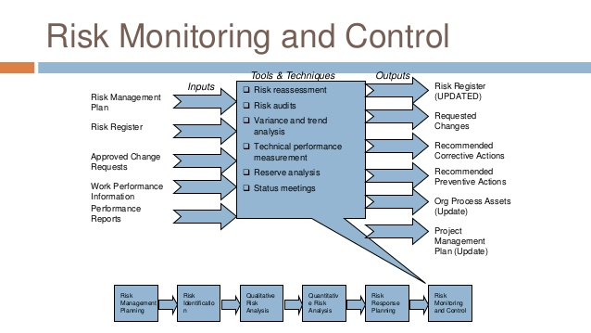
RISK MONITORING AND CONTROL

Slide 48
RISK MONITORING AND CONTROL
The list of actions involved in monitoring and controlling risks:
Determine the occurrences of risk triggers
Identify and monitor residual risks
Keep risk identification, analysis and monitoring an iterative process in the project
Evaluate the effectiveness of risk response plan
Risk status should be collected and communicated
Monitor the rigor of risk management procedures

Slide 49
RISK MONITORING AND CONTROL
The list of actions involved in monitoring and controlling risks(cont):
Identify if additional risk responses need to be determined
Recommend corrective actions
Look for unexpected effects or consequences
Update risk management and risk response plans
Perform variance and trend analysis
Use contingency reserves and adjust for approved changes

Slide 50
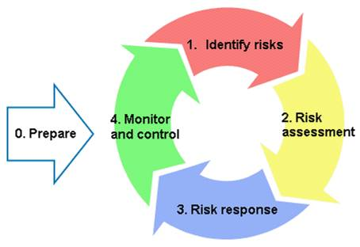
SUMMARY

Slide 51
THANK YOU FOR LISTENING AND WATCHING

